Slide 1
Array Oriented Functional Programming With Dyalog APL
Jay Foad Morten Kromberg Roger Hui

Slide 2
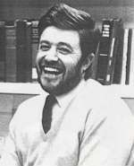
History of APL
Canadian of Norwegian Descent
Born on a small farm in Alberta (Canada)
Finished one-room school after 9th grade and worked on the farm
Army 1942, Flight Engineer in Air Force from 1943
Almost finished High School in the service
Promised his officers and mates that he would pursue an academic career after the war
B.A. from Queens University, Kingston Ontario
Ken didn’t know there was such a thing as University before he joined the army!
Kenneth E. Iverson 1920-2004
Notes:
Enjoyed teaching his mates math in the armed forces

Slide 3
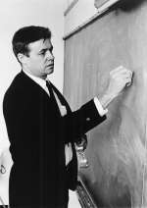
History of APL, continued
Doctoral work at Harvard with Aiken and Leontief
Taught at Harvard for 6 years,
frustrated with inadequacies of mathematical notation
Developed ”Iverson Notation” in response
Published ”A Programming Language” in 1962
Failed to get tenure at Harvard; moved to IBM
Used APL for modelling and teaching
First APL Interpreter in 1966
IBM Fellow in 1970
J (”rationalised APL”) from ca. 1989
ACM Turing award in 1979:
“For his pioneering effort in programming languages and mathematical notation resulting in what the
computing field now knows as APL, for his contributions to the implementation of interactive systems, to educational uses of APL, and to programming language theory and practice.”
Notes:
Leontied was awarded the Nobel Prize for Economics in …?

Slide 4











Syntaxes of Mathematics
Problems:
- Wide variety of syntactical forms
- Strange and inconsistent precedence rules - Things get worse when you deal with matrices See http://www.jsoftware.com/papers/EvalOrder.htm

Slide 5
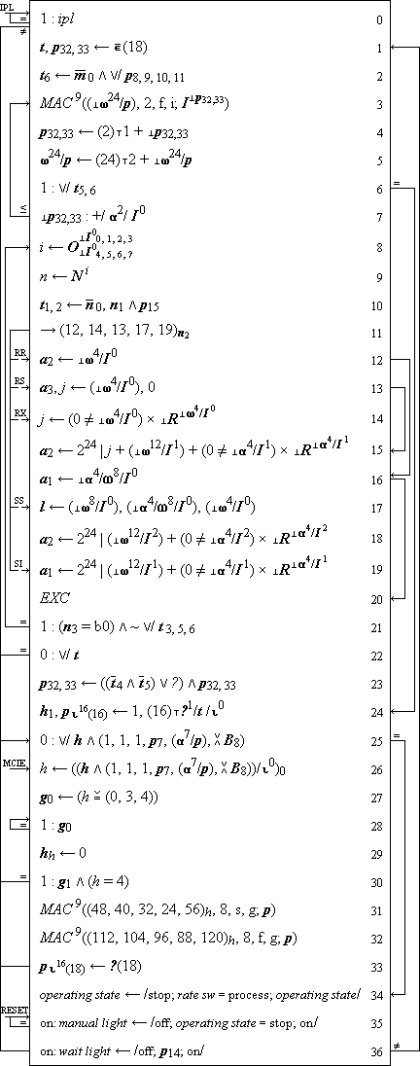
Iverson Notation: Description of IBM\360

Slide 6
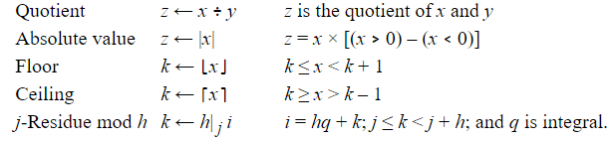
A Programming Language
The book, 1962

Slide 7
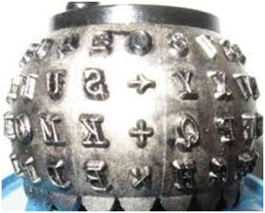
Linearization => APL\360
The 5: Ken Iverson, Adin Falkoff, Larry Breed, Dick Lathwell, Roger Moore. Operated by “Quaker Consensus”.
The first saved workspace:
)LOAD 1 CLEANSPACE SAVED 1966-11-27 15.53.59 (GMT-7)

Slide 8
A Programming Language (for Mathematics)
a×b
Mat1 +.× Mat2
*x
f g x
(f+g) x
x÷y
(3○x)*2
b⍟a
+/4×⍳6 ×/4×⍳6
a*÷n
(2×a)÷⍨(-b)(+,-)0.5*⍨(b*2)-4×a×c

Slide 9
Saving Your Work
Historically, APL users have saved workspaces containing code and data as a single file
Similar to an Excel Spreadsheet
Takes a ”snapshot of the VM”
Beware: also saves the execution stack if there is one
Save your work using )save /path/mywsname[.dws]
Load it again with )load /path/mywsname
You can extract named objects from a workspace: )copy /path/mywsname foo goo x y
Saved workspaces can have a ”latent expression” ⎕LX, which is executed when the workspace is loaded, unless you )xload /path/mywsname

Slide 10
Saving Your Work, continued
In the last few years, it has become more popular to use Unicode text files (and SVN/GIT), especially for source code
You can save a fn/var, namespace or class using]save (]save is a ”user command” - written in APL): ]save name /path/name[.dyalog] (it is customary to use the same name for the file)
You can bring it back into the active workspace using ]load /path/name ]load /path/*
If you edit objects that were ]loaded, the system will offer to update the file each time you make a change
From version 15.0, the interpreter (editor) knows how to open and view source files without user commands.

Slide 11
Indexing and Partial Assignment
]demo indexing.txt

Slide 12
Reading APL
CB←{⍵[1+(⍴⍵)|X∘.+X←(⍳⍺)-1]}
Imagine arguments: 8 CB ' ⎕'

Slide 13
Reading APL
life←{↑1 ⍵∨.∧3 4=+/,¯1 0 1∘.⊖¯1 0 1∘.⌽⊂⍵}
http://dfns.dyalog.com/n_life.htm http://www.youtube.com/watch?v=a9xAKttWgP4
Try it out in small chunks, starting from the right.
Know what's a function and what's an operator.
Note the creative use of inner product.
Finally try reading it from left to right.

Slide 14
Quirks that you may notice:
Some APL programmers like to avoid parentheses, to reduce the cognitive load!
Hence, put simple argument on left: 1+...
Or, use Commute: 2*⍨...
N.B. game of life has no parentheses, partly because (some) primitives (e.g. Residue) were carefully designed to be most useful with a simple constant on the left.

Slide 15
Reading APL
What does this function do?
{(~R∊R∘.×R)/R←1↓⍳⍵}
Or:
{{(~⍵∊⍵∘.×⍵)/⍵}1↓⍳⍵}

Slide 16
“Procedures”
Before dfns, APL had an imperative form now known as “tradfns”
The only control flow was → (goto)
Control structures (:If etc) arrived in the late 1980’s
Within “tradfns”, names have dynamic scope

Slide 17
Procedures / Tradfns
Monadic:
∇ R←Sum X
[1] R←+/X
∇
Dyadic:
∇ R←A MatMult B
[1] R←A+.×B
∇
Niladic:
∇ Run
[1] ⎕←'Boo Hiss!'
∇

Slide 18
Procedures / Tradfns
”Ambi-valent” (+ use a control structure)
∇ R←{Window} Sum X
[1] :If 0=⎕NC 'Window' ⋄ R←+/X [2] :Else ⋄ R←Window +/ X
[3] :EndIf
∇

Slide 19
Procedures / Tradfns
Name Elements of Right Argument
+ Local Variable
+ Class / DotNet declarations
∇ r←Round(n decimals);base
[1] :Access Public Shared
[2] :Signature Double←Round Double N, Int32 Decimals
[3] base←10*decimals
[4] r←(⌊0.5+n×base)÷base
∇

Slide 20
Errors
1 2 3÷4 5 LENGTH ERROR 1 2 3÷4 5 ∧
⎕EN 5
1÷0 DOMAIN ERROR: Divide by zero 1÷0 ∧
⎕EN (⎕EM 11)
11 DOMAIN ERROR
⎕DMX.Message Divide by zero

Slide 21
Errors
18 FILE TIE ERROR
19 FILE ACCESS ERROR
20 FILE INDEX ERROR
21 FILE FULL
22 FILE NAME ERROR
23 FILE DAMAGED
24 FILE TIED
25 FILE TIED REMOTELY
26 FILE SYSTEM ERROR
28 FILE SYSTEM NOT AVAILABLE
30 FILE SYSTEM TIES USED UP
31 FILE TIE QUOTA USED UP
32 FILE NAME QUOTA USED UP
34 FILE SYSTEM NO SPACE
35 FILE ACCESS ERROR - CONVERTING FILE
36 INCOMPATIBLE ARRAY
38 FILE COMPONENT DAMAGED
1 WS FULL
2 SYNTAX ERROR
3 INDEX ERROR
4 RANK ERROR
5 LENGTH ERROR
6 VALUE ERROR
7 FORMAT ERROR
10 LIMIT ERROR
11 DOMAIN ERROR
12 HOLD ERROR
13 OPTION ERROR
15 LST FULL
16 NONCE ERROR
17 ACCESS ERROR

Slide 22
Error Trapping: Dfns
div←{0::'Something Else is Wrong' 11::0 ⍝ DOMAIN error: return 0 ⍺÷⍵}
3 div 0 0
1 2 3 div 4 5 Something Else is Wrong

Slide 23
Error Trapping: Tradfns
Using :Trap
∇ R←A DIV B
[1] :Trap 0
[2] R←A÷B
[3] :Case 11 ⋄ R←0 ⍝ DOMAIN error
[4] :Else ⋄ R←'Something Else is Wrong'
[5] :EndTrap
∇

Slide 24
Error Trapping: Tradfns
Using ⎕TRAP
∇ R←A DIVQ B;⎕TRAP
[1]
[2] ⎕TRAP←(11 'E' '→DOMERR')(0 'C' '→CATCHALL')
[3] R←A÷B ⋄ →0
[4]
[5] DOMERR:→R←0
[6] CATCHALL:R←'Something Else is Wrong'
∇

Slide 25
System Functions
(built-in library functions)
]demo sysfns.txt

Slide 26
Building Applications
Delivery Mechanisms:
Saved Workspace
Workspace Bound with Interpreter as an .exe
COM Server
Microsoft.Net Assembly
ASP.Net scripting language, Web Services, SharePoint Web Parts, WCF, etc etc etc etc
“Stand Alone” Web Server, Web Service

Slide 27
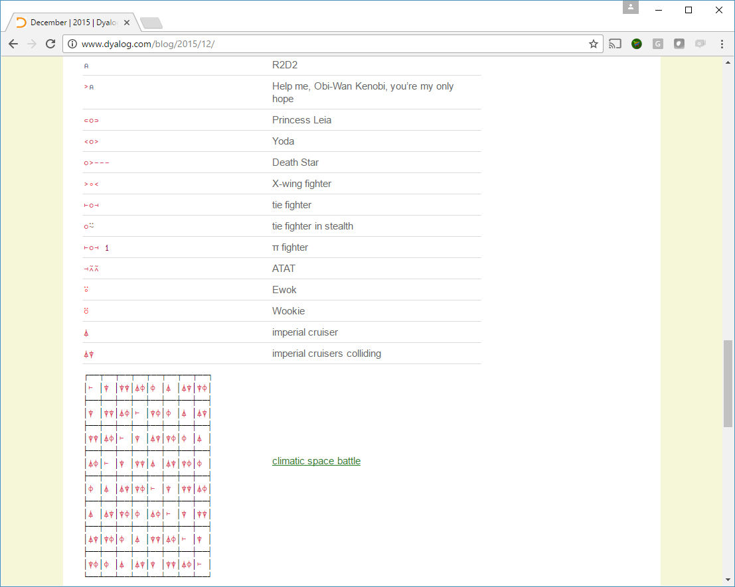
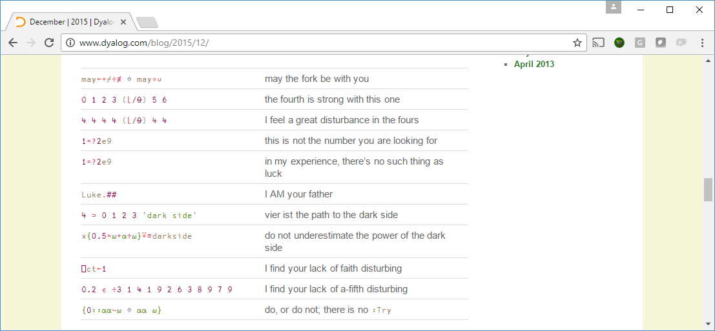
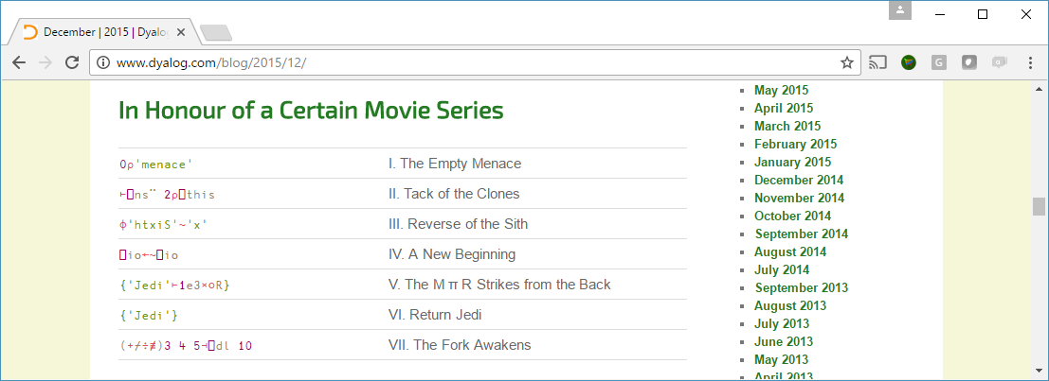
Star Wars

